Slide 1


What have people told us about their experiences with pharmacies?
January to October 2024

Slide 2




1. Overview of insights

Slide 3
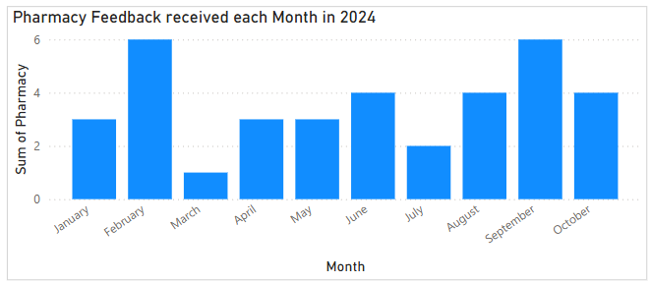
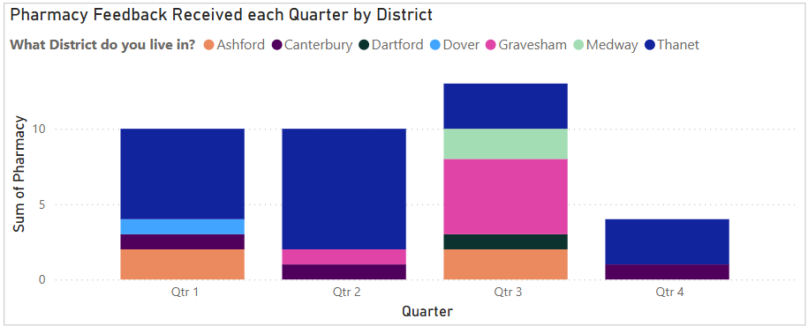
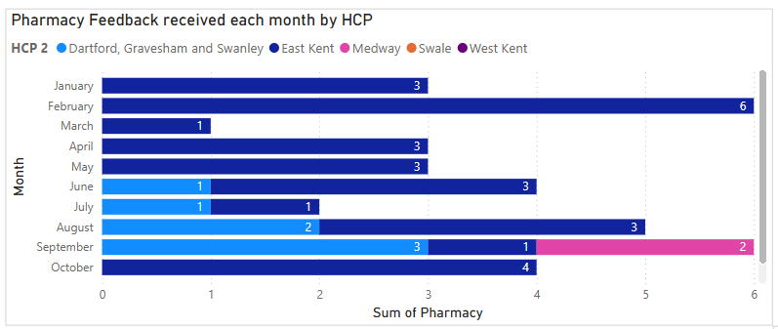
Where are we hearing from?
Mental Health Voice received 37 pieces of feedback about people’s experiences with pharmacies from 1 January to
31 October 2024.
Of this, 28 pieces of feedback were from East Kent, seven from Dartford, Gravesham and Swanley and two from Medway.
The feedback was obtained through solicited and unsolicited engagement with people with lived experience of mental health issues, however, was not limited to mental health-related care and could also be about physical health.

Slide 4
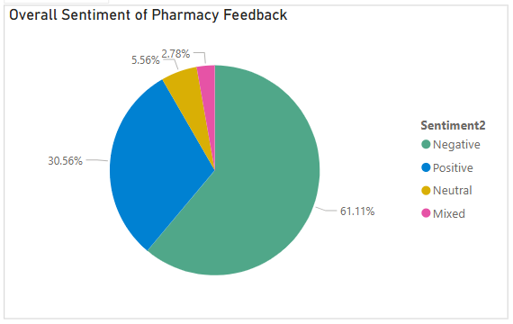
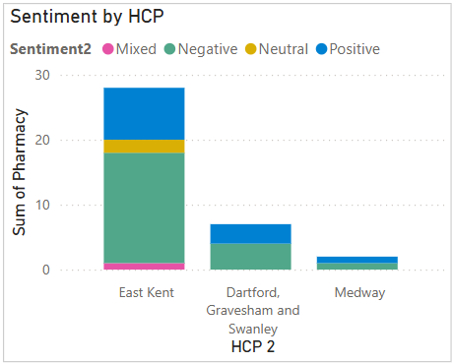
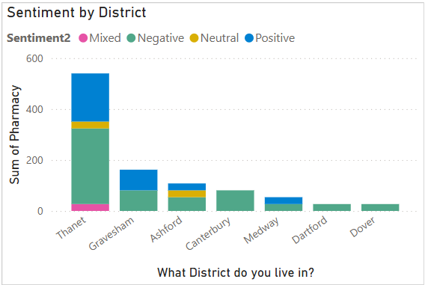
How do people feel about their experiences with pharmacies?
61% of feedback was negative and 30% positive.
Sentiment across health and care partnership areas (HCP) and district seems consistent, despite limited numbers of feedback received in some areas.

Slide 5
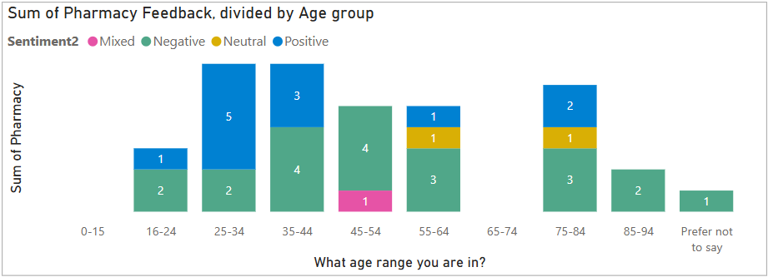
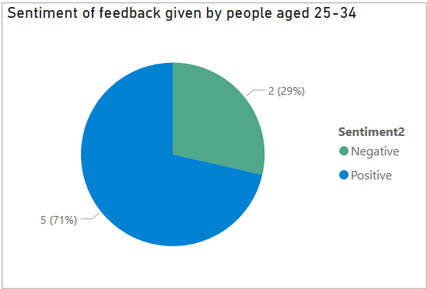
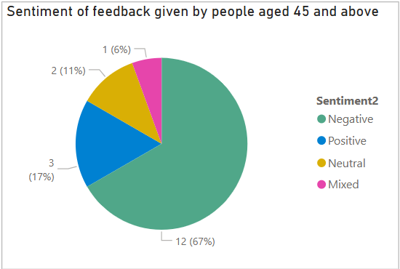
Demographics – age
Throughout 2024, we heard the most from those aged 25–44, making up 38% of pharmacy feedback received.
The distribution of feedback is quite consistent and therefore unlikely to skew findings.
We did not receive any feedback from under 16s or those aged 65–74.
Sentiment of feedback varied greatly between age groups.
71% of feedback received by
25–34-year-olds was positive.
This was in stark contrast to feedback from those aged 45 and older, which was mostly negative (67%).

Slide 6
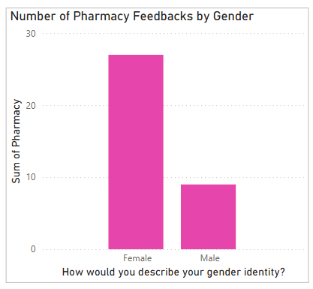
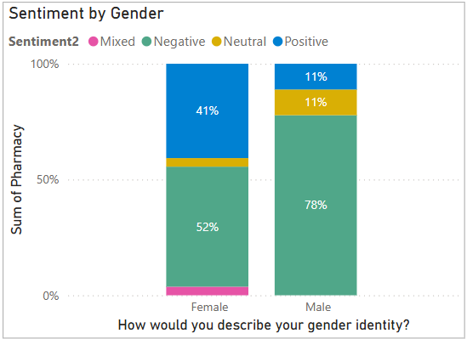
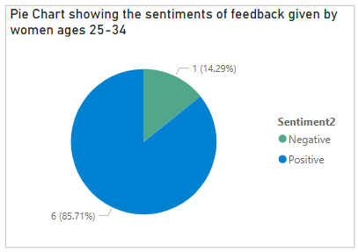
Demographics – gender
Most of the feedback received was from women, who also had more instances of positive experiences than men.
Interestingly, when gender interacts with age, it intensifies the positive/negative age trend described previously: While women have more positive experiences than men, younger women are having even more positive experiences than older women, who report difficulties with contacting pharmacies and picking up medications.
Men reported more negative experiences, although analysis of any intersection with age is limited by the number of responses received from men.

Slide 7
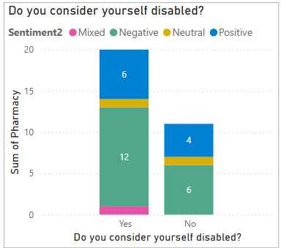
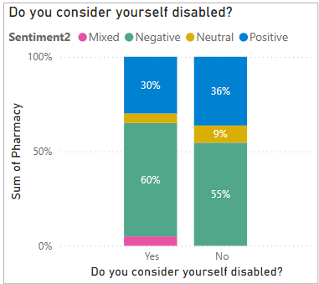
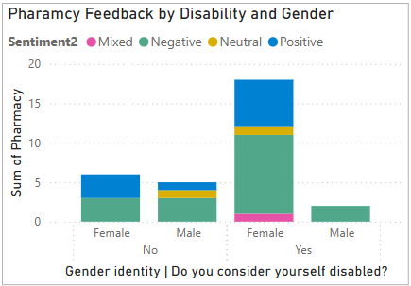
Demographics – disability
Most of the feedback received was from people who considered themselves disabled.
Of these people, fewer had positive experiences (30%) than those who did not consider themselves disabled (36%).
The majority of those that considered themselves disabled were women. Of these, 33% reported positive experiences compared to 50% of women who did not consider themselves disabled.
This suggests that sentiment of feedback from women who considered themselves disabled was approximately the same as those who did not, if allowing for the limitations of sample size.

Slide 8
2. Comparing findings for pharmacy to other services
Comparative analysis allows us to see if insights from pharmacy feedback are unique to pharmacy experiences, or if these are general trends seen across all feedback.

Slide 9
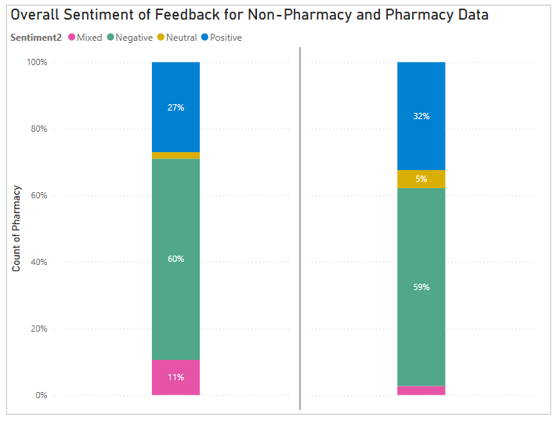
Comparing overall sentiment
The key trends we are testing against feedback about services other than pharmacy are age and gender as these were the most significant findings so far. Comparison is undertaken to see how trends seen in the feedback so far compare to other services. Is this unique to pharmacy feedback, or like what we heard about other services?
Other services
Pharmacy
The proportion of negative sentiment about pharmacy compared to other services sees no significant change at 61% and 59%, respectively. Pharmacy feedback does, however, have less mixed sentiment (3%) than other services (11%).
Pharmacy feedback is slightly more positive compared to feedback about other services (32% compared to 27%).

Slide 10
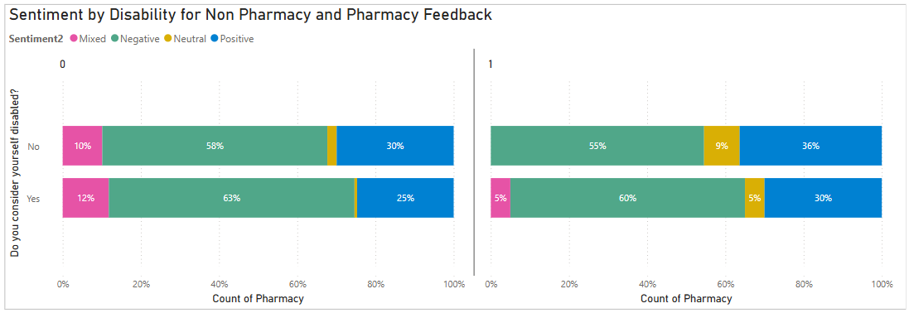
Comparing disability feedback
Non-Pharmacy
Pharmacy
The proportion of positive and negative sentiment for pharmacies does not vary based upon whether people do or do not consider themselves disabled.
Those consider themselves disabled are reporting more positive experiences with pharmacies than other services (30% compared to 25%), as do those who do not consider themselves as disabled (36% compared to 30%).
The reports of negative experiences has not seen much difference for feedback about pharmacy or other services, whether or not people consider themselves disabled.

Slide 11
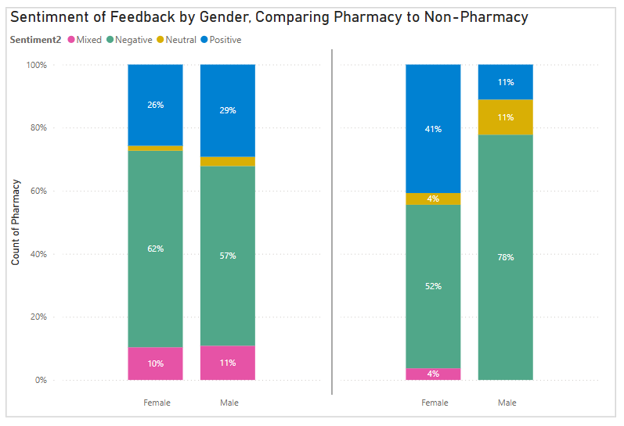
Comparing feedback by gender
Other services
Pharmacy
The previous findings that different genders experience pharmacies differently are supported by comparison with feedback about other services: This is not a trend within the wider feedback and suggests a unique experiences for men and women in pharmacy services.
Women are reporting much more positive feedback with pharmacies compared to other services (41% vs 26%).
Conversely, men are reporting more negative experiences and less positive experiences with pharmacies (29% down to 11%).

Slide 12
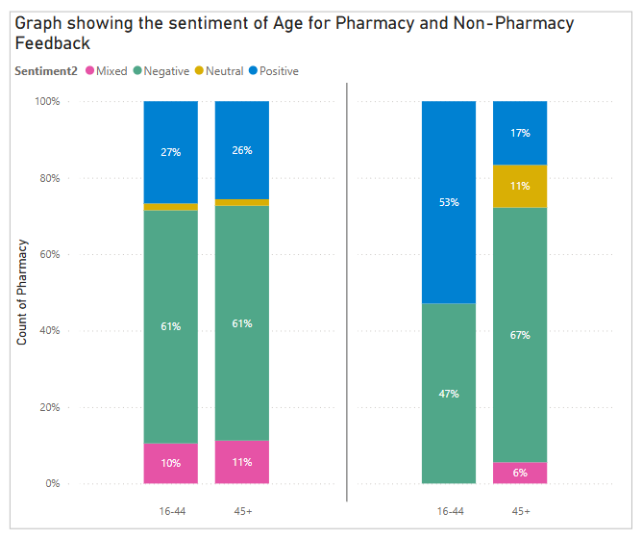
Comparing Feedback by Age
Non-Pharmacy
Pharmacy
Younger people were reporting more positive experiences with pharmacies when compared to older people. This is supported by comparison to feedback about other services, with this being a trend unique to Pharmacy Feedback.
Those aged 16-44 gave significantly more positive feedback for pharmacies, compared to other services (53% compared to 27%).
Those aged 45 and over have reported fewer positive experiences with pharmacies than other services (26% down to 17%), along with more negative feedback.

Slide 13
Overall findings
Women had significantly more positive experiences with pharmacies than men (41% compared to 11%), particularly those aged 25–34.
Pharmacy feedback was slightly more positive than feedback about other services (32% compared to 27%).
    This was the case whether the people who gave the feedback consider themselves disabled or not.
Women had much more positive experiences with pharmacies compared to other services (41% compared to 26%).
Conversely, men reported more negative experiences with pharmacies than other services (78% compared to 57%). The strength of this finding is, however, limited by the quantity of feedback from men about pharmacies.
Younger people had more positive experiences than older people. Those aged 16–44 gave significantly more positive feedback about pharmacies than other services (53% compared to 27%), whereas people aged 45 and over gave slightly more negative feedback about pharmacies than other services (67% compared to 62%). This may suggest improvements are needed so that older patients can access Pharmacy First successfully.

Slide 14
3. Why are people having positive or negative experiences with pharmacies?
Qualitative analysis of data gives insights into what might be driving positive experiences, particularly why women and younger people are having more or less positive experiences with pharmacies compared to their counterparts.

Slide 15
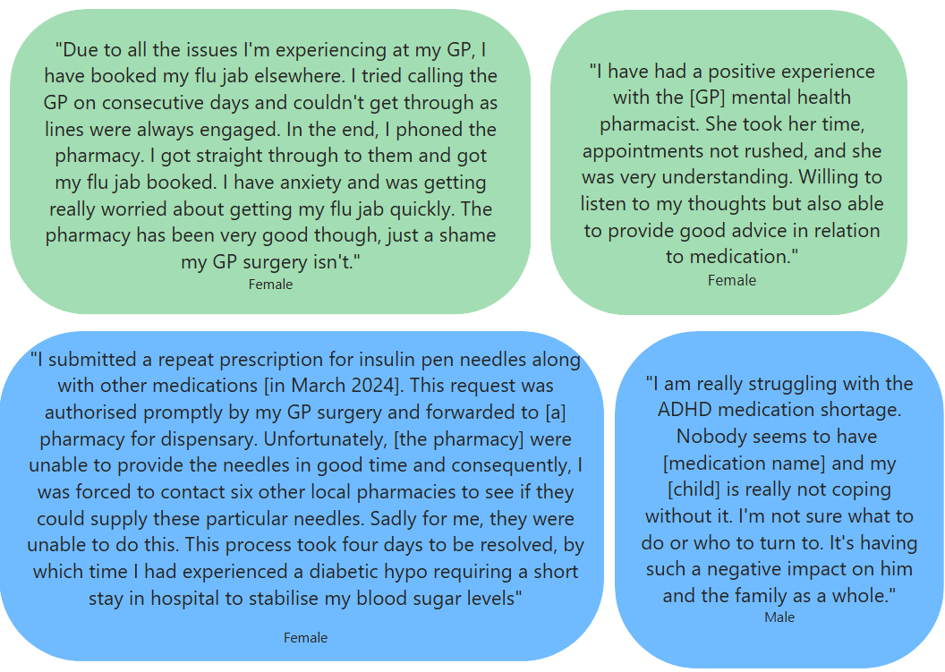
People’s voices
Positive experiences tend to be linked to key themes of receiving treatment when unable to get through to the GP or having challenges with other services such as mental health.
Other positive themes are receiving medications and medication guidance promptly, particularly antibiotics and vaccinations.
Negative feedback is commonly associated with medications not being available and communication etc. This is the case for men and women, however, ...
… all nine accounts from men were associated with medication dispensary, of which six reported difficulty accessing medication due to stock issues, with a third of these associated with ADHD medication.
This could suggest that women are utilising the pharmacy for a more diverse range of services, inline with Pharmacy First, when compared to men.

Slide 16
4. Have experiences changed since the implementation of Pharmacy First?
Looking at what people were saying regarding pharmacies before and after 31 January 2024 to see if pharmacy first has had any significant effect on experiences with community care services.

Slide 17
What is the Pharmacy First initiative?
Launched on 31 January 2024, the Pharmacy First scheme builds upon the consultation service and enables community pharmacies to complete episodes of care for seven common conditions, enabling patients to receive prescription and urgent medications without accessing the GP.
The seven common pathways:
Ear infection in children
Impetigo (from 1 years old)
Infected insect bites
Shingles in adults
Sinusitis (from 12 years old)
Sore throat (from 5 years old)
Uncomplicated urinary tract infections in women (ages 16-64 years)
The aim of this project is to see how patients are experiencing pharmacy care, and to assess if the pharmacy first programme has been beneficial to the people of Kent when accessing healthcare.

Slide 18
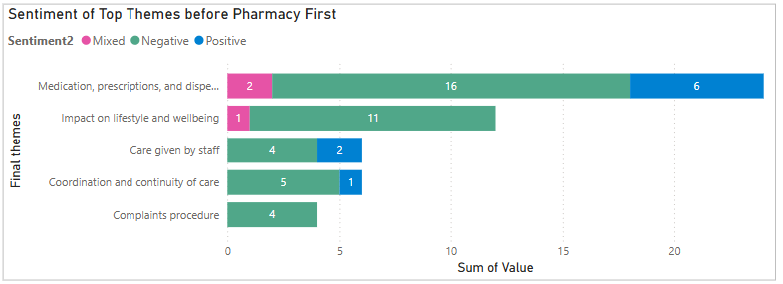
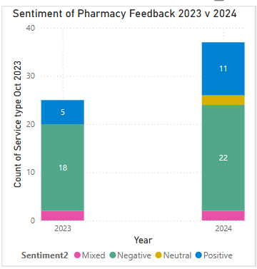
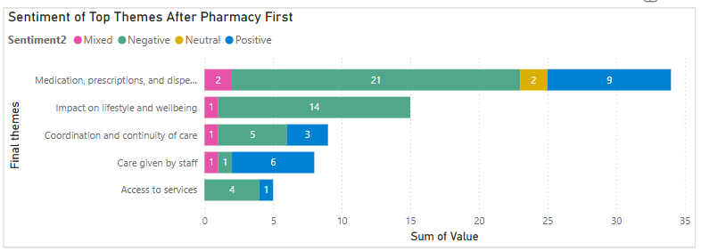
Overview – themes and sentiment
The top five themes of feedback received are the same before and after Pharmacy First.
The sentiment of these themes also do not show any major changes.
We have heard more pharmacy feedback in 2024, compared to 2023, with a slight increase in positive experiences.

Slide 19
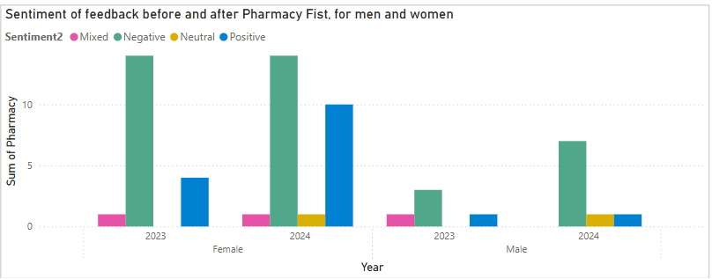
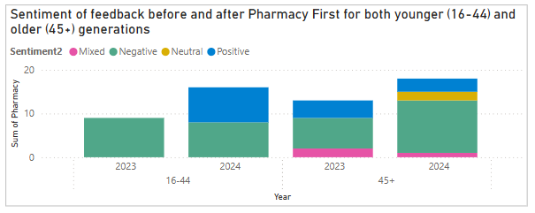
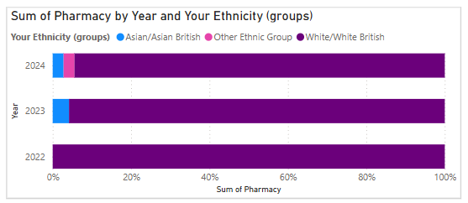
Changes over time - demographics
Looking at changes over time allows us to see if anything has changed since the implementation of Pharmacy First and therefore comment on its effectiveness on people's healthcare experiences.
Previous trends are supported, with an increase in positive feedback from women and younger people accessing pharmacies since the implementation of Pharmacy First.

Slide 20
Findings
Gender continues to show contrasting findings, with women seeming to have more positive experiences than men. A significant increase in positive experiences from women can be seen from 2023 to 2024, while feedback from men saw a slight increase in negative sentiment.
Age, split into two broad categories, demonstrates an increase in positive experiences for 16–44-year-olds since the start of 2024, with 50% of all feedback for this age group being positive. Prior to Pharmacy First, there was no positive feedback from this age group.
Feedback from older people did not show much change since Pharmacy First and could suggest some barriers in their accessing of the scheme. This would require further investigation.
There are no significant findings in relation to ethnicity due to limited feedback received from people of diverse ethnicities.
This could suggest that Pharmacy First is being accessed more by younger people and, notably, women. Many positive experiences discuss the pharmacy being able to support with health concerns such as jabs, antibiotics and consultation, whereas negative feedback, reported predominantly by men, is centred around medication availability issues.

Slide 21
5. How do pharmacies work in connection with other services?
Drawing feedback from other services to assess the coordination of care with pharmacy referrals.

Slide 22
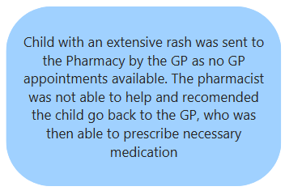
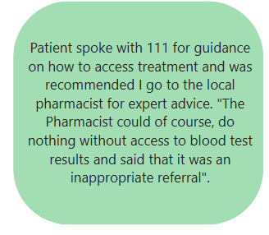
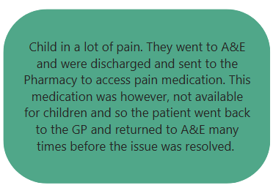
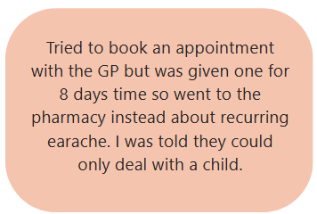
People’s Voices – coordination of services
Some people are attempting to access pharmacies before other services but are being redirected back to their GP due to barriers such as pharmacists requiring blood tests or being unable to provide specific medications, particularly for children.
Complications with the coordination of services is reducing people’s ability to access pharmacies for common pathways of care.

Slide 23
6. Conclusions
Overall conclusions from across the analyses.

Slide 24
Overall conclusions
Men and women are accessing pharmacies for different reasons and seem to have different experiences because of this.
Women appear to be more likely to go to the pharmacy for a diverse range of issues such as receiving urgent prescriptions, antibiotics, medical advice and vaccinations and seem to be having positive experiences with this.
Feedback from men did not reference Pharmacy First pathways, with 100% of feedback received from men mentioning medication dispensary, particularly noting stock issues and pharmacy closures as areas of concern.
Other negative experiences discussed challenges with arranging transport to pick up prescriptions that were not ready, despite having text notification that they were.
Trends seen with women and younger people having more positive experiences are not seen in feedback about other services and are unique insights into pharmacy services.
Compared to feedback about other services, younger women seem to have more positive experiences. This trend emerges post-Pharmacy First. This suggests that people have differing experiences due to their age and gender as they are going to the pharmacy for different reasons.
Coordination of services seem to present barriers onto the effectiveness of the Pharmacy First scheme, with many people being sent to multiple services before receiving relevant treatment despite them going to the pharmacy first.

Slide 25
Thank you

